Slide 1

MAVEN

Slide 2
What is Maven?
Why Maven?
What is Pom.xml?
Maven Build Life Cycle
Dependencies and Plugins
Transitive Dependency and Multi module projects
Trips & Tricks

Slide 3
What is Maven?
Maven is a Software management and comprehension tool primarily used for Java based projects
But that can also be used to manage projects in other programming languages like C# and Rubby.
Maven helps manage build, documentation, reporting, dependencies, Software configuration
Management (SCM), releases and distribution.
Many integrated development environments (IDEs) provide plug-ins or add-ons for Maven, thus
Enabling Maven to compile projects from within the IDE

Slide 4
Why Maven?
Before maven, we have Ant as a build tool. This needs a lot of configuration like where the source
code exists, where the output should be stored and many more.
Maven uses Convention over Configuration, which means developers are not required to create
build process themselves.
Item | Default
Source Code | $(basedir)/src/main/java
Resources | $(basedir)/src/main/resources
Test | $(basedir)/src/test
Compiled Byte Code | $(Basedir)/target/classes
Distributable JAR/WAR | $(basedir)/target

Slide 5
Please visit this GitHub URL for the detailed information
https://github.com/dhanvantarisoftware/Maven_Class
Please go through this URL https://github.com/dhanvantarisoftware/Maven_Class/blob/main/Ant_example/build.xml
As we can see in the next slide it shows that manually we have to configure where the source code exists, test cases and
Target (Artifactory) manually

Slide 6
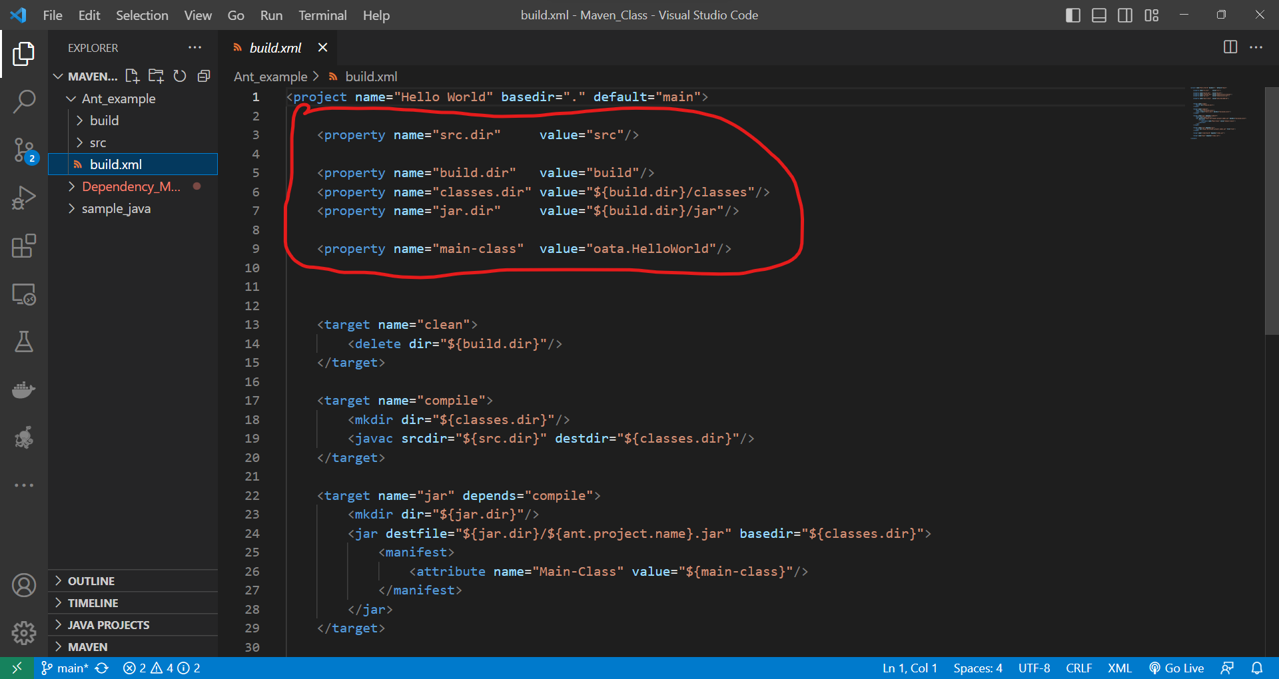

Slide 7
Pom.xml?
POM stands for Project Object Model
It is fundamental unit of work in Maven
It is an XML file that resides in the base directory of the project as pom.xml
POM also contains the goals and plugins. While executing a task or goal, Maven looks for the POM
in the current directory. It reads the POM, gets the needed configuration information and then
executes the goal. Some of the configuration that can be specified in the POM are following
Project Dependencies
Plugins
Goals
Build Profiles
Project Version
Developers
Mailing List

Slide 8
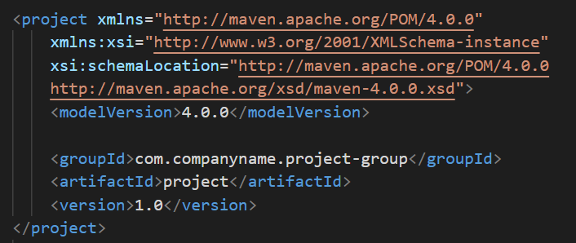
POM Example
It should be noted that there should be a single POM file for each project
ALL POM files require the project element and three mandatory fiels
groupId, atrifactId, version
Project notation in repository in groupId:artifactId:version

Slide 9
